Slide 1
The Green Book
PowerPoint By Caroline Heaphy

Slide 2
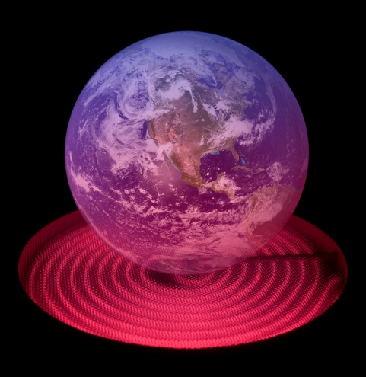
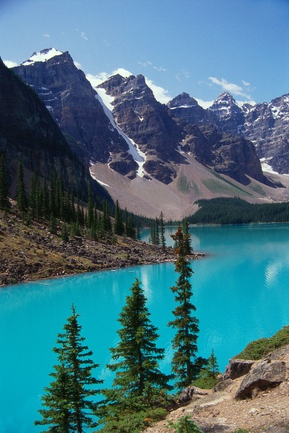
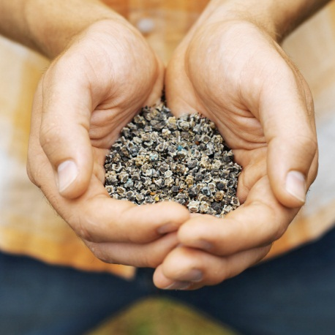
History of the humans on Shine
Around 15 people travelled from Earth to Shine
Only 15 could fit in the spaceship and 15 were needed to survive on Shine
Chose Shine because it was similar to earth
Planned on having families and living their whole lives on Shine
The people planted seeds to grow into food
They made friends with the moth creatures by giving them sugar cubes
Chopped down trees to build huts
Enjoyed swimming in lakes and saw jellyfish that swam away

Slide 3

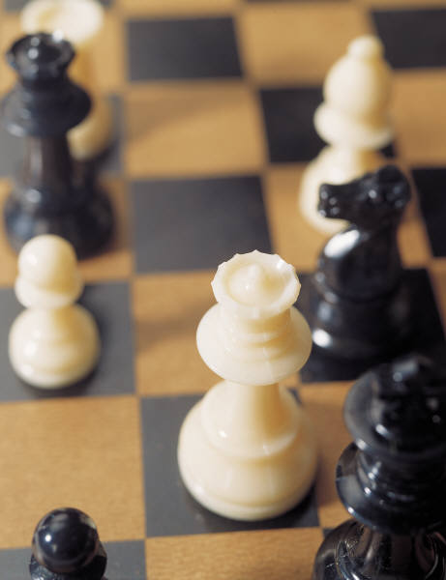
Traveling to Shine
It takes 4 years to travel from Earth to Shine
You can play games and read on the ship
You can be any age to travel to Shine
There are exercising machines on the ship
The children can take care of and play with rabbits

Slide 4
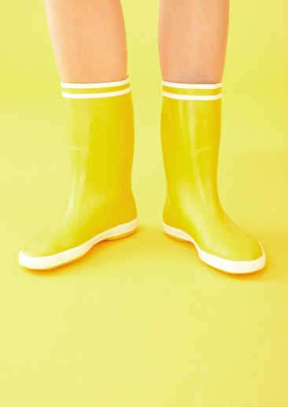
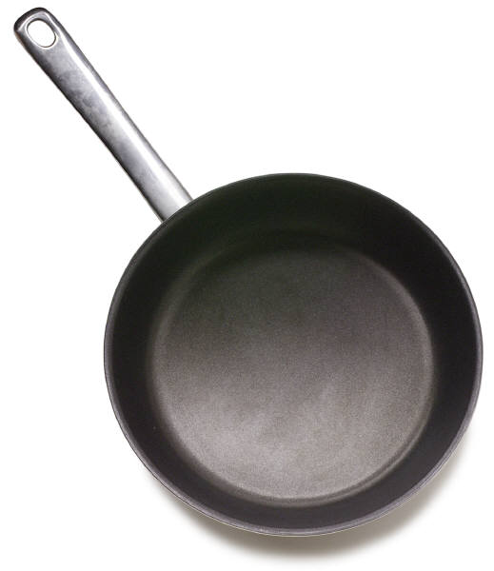


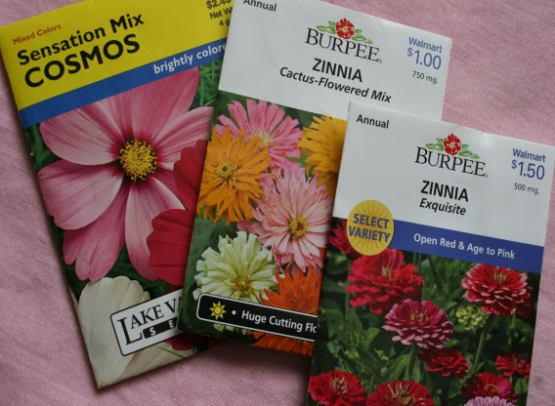
What to bring
A spade, saw, file, ax for each family
Seeds and iron rations will be provided
For each voyager a pair of cloths, Boots and 1 or 2 personal items
Cooking pan, a musical interment
A picture small and unframed
1 book for each person

Slide 5


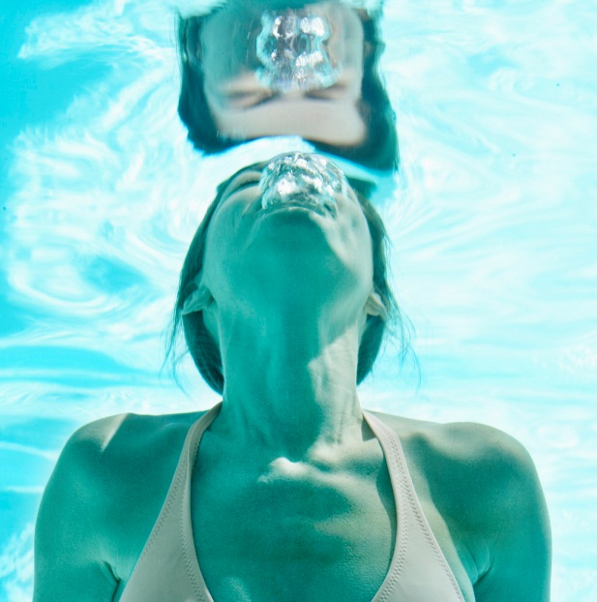
Weather on shine
There are no clouds
Rains every night
Sun shines every day
Warm enough for growing food, plants and swimming
Similar weather to earth

Slide 6
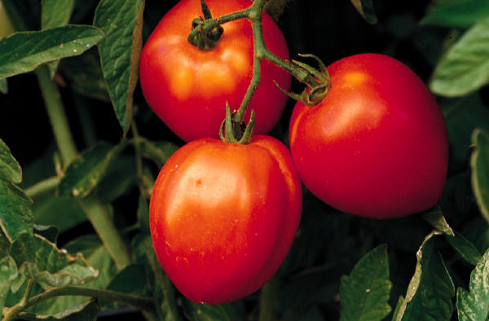
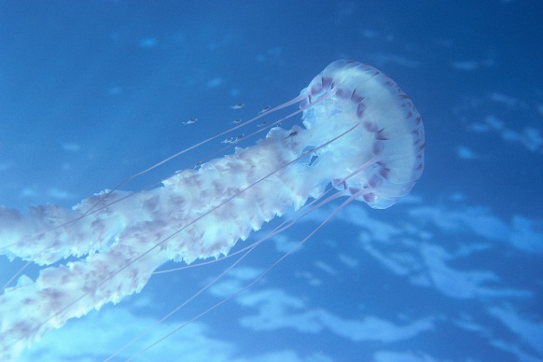
Wildlife on Shine
In the lakes there are jelly fish that don’t sting you
There are mothpeople
Mothpeople are nice creatures that eat sugar cubes and have a moth body with a human head
Flowers grow and food does too
There is nothing that can hurt you

Slide 7
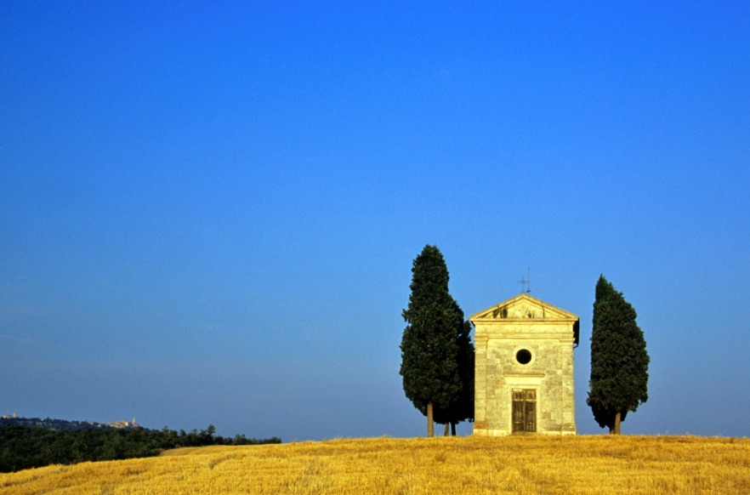
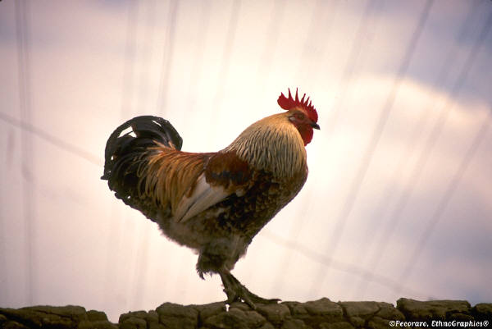
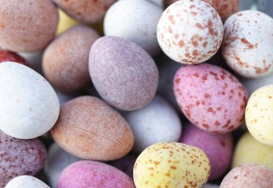
Survival on shine
Like Earth, Shine has water oxygen and sun
They build huts
They bring chicken so that they have eggs
They brought seeds and planted them, they grew into good food
Four men went around Shine in a landhopper and searched the land
A landhopper is a car like vehicle

